Slide 1
Recursion

Slide 2
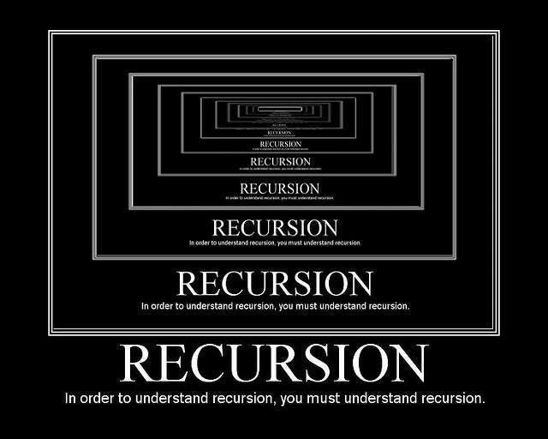
What is Recursion?
Recursion is when a function calls itself.
Recursion definition: “The act of defining an object (usually a function) in terms of that object itself” (Wikipedia)
Recursion isn’t specific to programming, but it’s often used in programming.

Slide 3
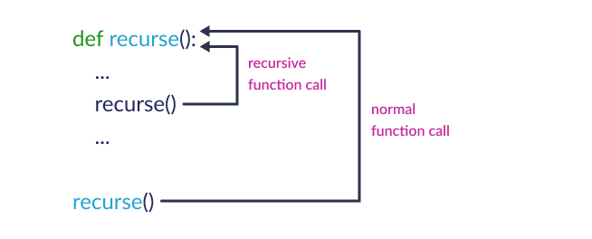
What does recursion look like?

Slide 4
Exercise
Write a recursion function that will accept the integer value of 10 and will count down until zero and print the message, “Blast off!” to the user when we hit our base case!

Slide 5
Recursion - End Condition
Make sure to have an end condition that stops recursion, otherwise you can enter an infinite loop.
You can think of this like the condition that stops a while loop

Slide 6
Recursion vs Loops
Often, recursion and loops can be used interchangeably. Here is the code from the previous slide as a loop:
def count_down(n):
for i in range(n, 0, -1):
print(i)
print("Blast off!")
count_down(3)
This time our “end condition” is when our for loop exits, because we’ve looped through the entire range

Slide 7
Exercise - Factorial
The factorial of a positive integer n is written in math as n!
Factorial of 10
10! = 10 x 9 x 8 x 7 x 6 x 5 x 4 x 3 x 2 x 1
3,628,800
Factorial of a number is the multiplication of all the numbers from 1 and leading up to that number.
Write a recursive function that takes a parameter n and returns the factorial of n.

Slide 8
When to use recursion vs. loops
How do you decide which is best?
There are many factors to consider:
Which is more efficient (takes less time to run)? Usually loops are more efficient, because recursion takes a lot of memory - it has to keep track of every function call.
Which is easier to write? At first, recursion might seem difficult, but as you get more used to it, there are situations where it makes more intuitive sense than loops, such as Fibonacci or factorial.

Slide 9
Example
Write a recursive function that multiplies two numbers, using addition.
The function multiply(m, n) should return m*n

Slide 10
Exercise
Using the previous example as reference, write a recursive function that takes one number to the power of another number, using multiplication.
The function power(m, n) should return m**n

Slide 11
September Challenge - Fibonacci Sequence
The Fibonacci sequence is a pattern that often appears in nature. This is the pattern: 1, 1, 2, 3, 5, 8, 13, ...
Each number is the sum of the two numbers before it. So, element n of the Fibonacci sequence can be computed like this: n = (n-1) + (n-2)
Patterns like this lend themselves to recursion very naturally.
How would you write a recursive function that computes the first n digits of the Fibonacci sequence?

